Slide 1
BabySpartan: Lasso based SNARK for non-uniform computation
Work by- Srinath Setty, Justin Thaler (ePrint 2023/1799)
Presented by Ashutosh Marwah

Slide 2
BabySpartan
BabySpartan = SuperSpartan [STW23a] + Lasso [STW23b]
SNARK for a large class of CCS (particularly Plonkish)
Based on IOP in SuperSpartan
Ensure committed values are all “small”- even for non-uniform circuits
Introduces Customizable Constraint System (CCS), a generalization of R1CS
Provides poly IOP & SNARKs for CCS
For “uniform” circuits Prover commits only to small values
Efficient lookup arguments
Ensure committed field elements are all “small”

Slide 3
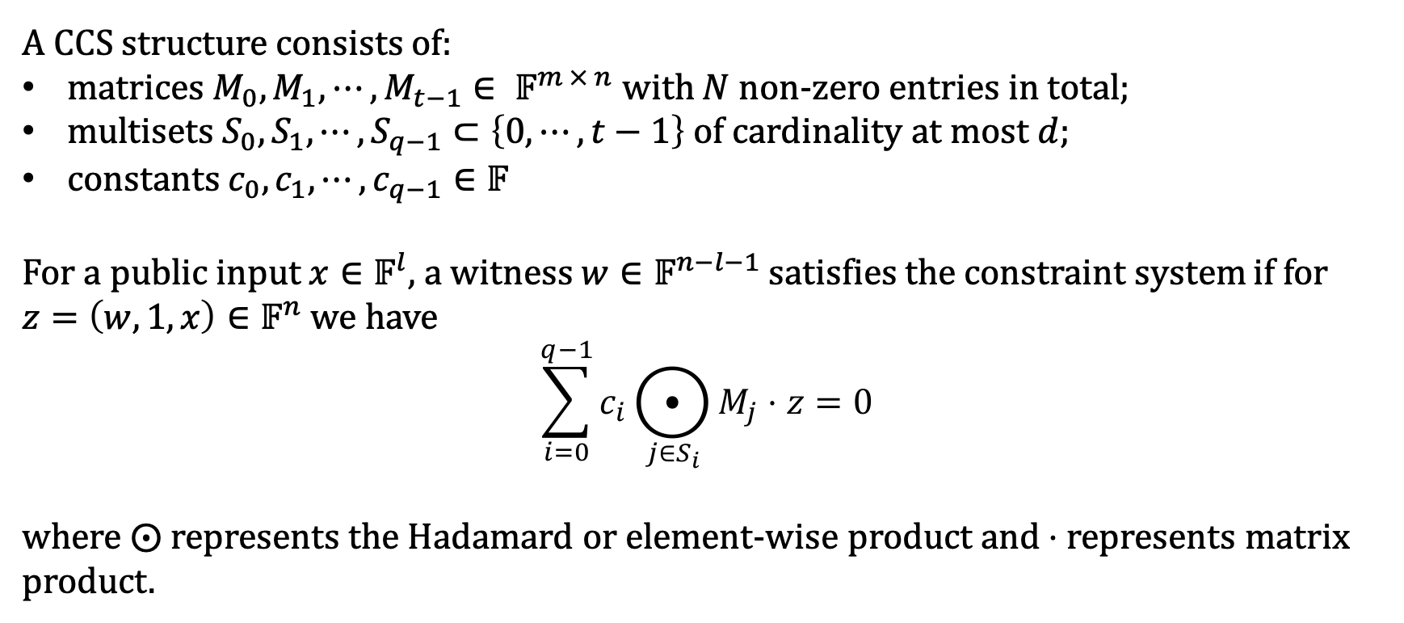
Customizable Constraint System (CCS)
A CCS structure consists of:
matrices $M_{0}, M_{1}, ⋯, M_{t−1}∈ 𝔽^{m × n}$ with $N$ non-zero entries in total;
multisets $S_{0}, S_{1}, ⋯, S_{q−1}⊂\left\{0, ⋯, t−1\right\}$ of cardinality at most $d$;
constants $c_{0}, c_{1}, ⋯, c_{q−1}∈𝔽$
For a public input $x∈𝔽^{l}$, a witness $w∈𝔽^{n−l−1}$ satisfies the constraint system if for $z=\left(w, 1, x\right)∈𝔽^{n}$ we have
$$\sum_{i=0}^{q−1}{c_{i}⨀_{j∈S_{i}}{M_{j}⋅z}}=0$$
where $⨀$ represents the Hadamard or element-wise product and $⋅$ represents matrix product.

Slide 4
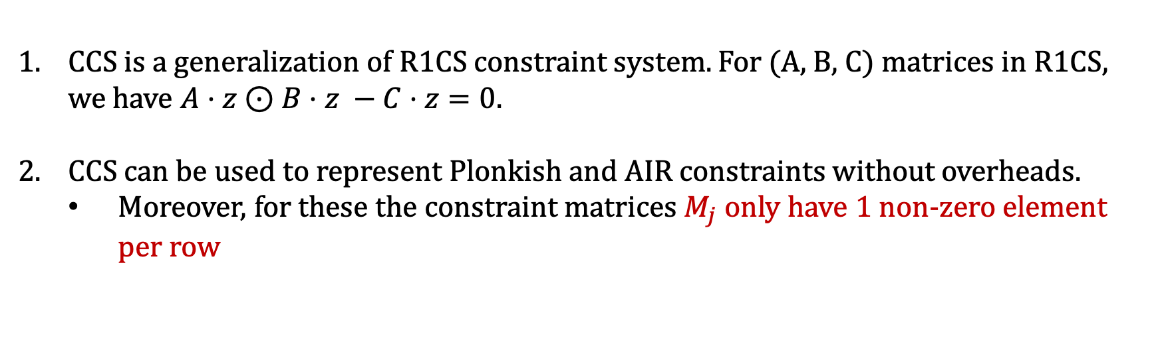
Customizable Constraint System (CCS)
CCS is a generalization of R1CS constraint system. For (A, B, C) matrices in R1CS, we have $A⋅z⊙B⋅z −C⋅z=0$.
CCS can be used to represent Plonkish and AIR constraints without overheads.
  Moreover, for these the constraint matrices $M_{j}$ only have 1 non-zero element per row
For BabySpartan, we will focus on such CCS structures

Slide 5

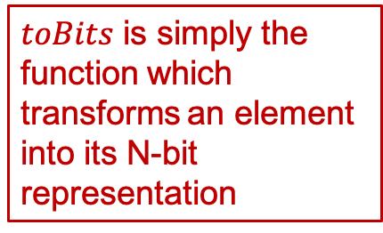

Offline memory checking
Problem: Suppose the Verifier has (oracle) access to the multilinear extensions of the polynomials
$$v :{\left\{0,1\right\}}^{\log{m}}→𝔽 \\ T :{\left\{0,1\right\}}^{\log{N}}→𝔽$$
$$g :{\left\{0,1\right\}}^{\log{m}}→𝔽$$
where $m≤N$. For an honest prover, $v$ lies in $\{0, ⋯, N−1\}$. Suppose the Prover wishes to prove that the MLE of $g$, $\tilde{g}$ satisfies
$$\tilde{g}\left(x\right)=T\left(toBits\left(v\left(x\right)\right)\right) \text{for} \text{every} x∈ {\left\{0,1\right\}}^{\log{m}}.$$
How can the Prover do this?
$toBits$ is simply the function which transforms an element into its N-bit representation
We will represent the MLE of a polynomial $p$ by $\tilde{p}$.

Slide 6
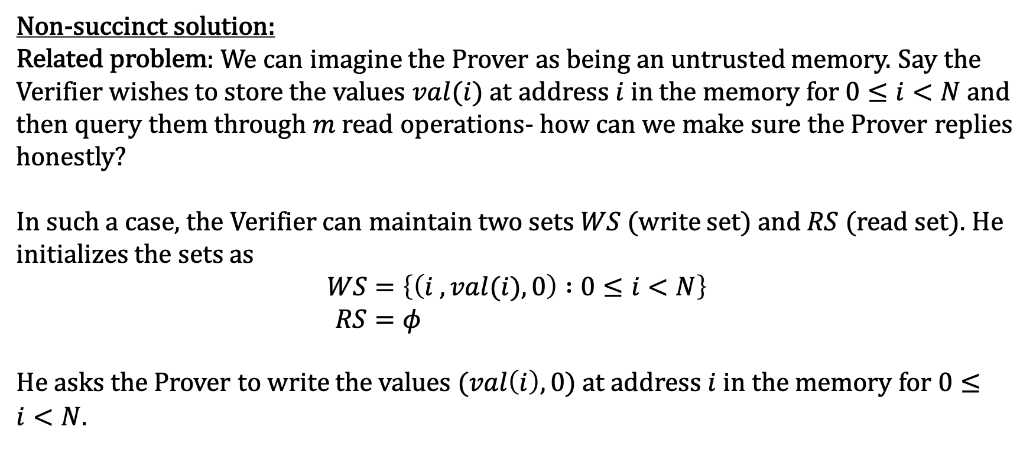
Offline memory checking: general solution
Non-succinct solution:
Related problem: We can imagine the Prover as being an untrusted memory. Say the Verifier wishes to store the values $val(i)$ at address $i$ in the memory for $0≤i<N$ and then query them through $m$ read operations- how can we make sure the Prover replies honestly?
In such a case, the Verifier can maintain two sets $WS$ (write set) and $RS$ (read set). He initializes the sets as
$$WS=\left\{\left(i , val(i), 0\right) :0≤i<N\right\} \\ RS=φ$$
He asks the Prover to write the values $(val\left(i\right),0)$ at address $i$ in the memory for $0≤i<N$.

Slide 7
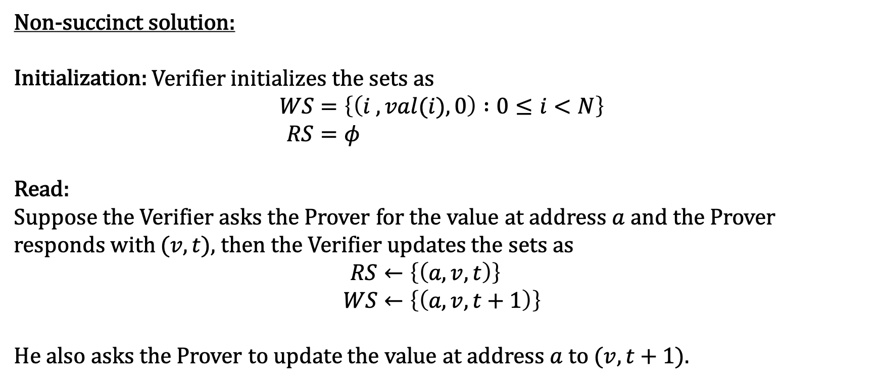
Offline memory checking: general solution
Non-succinct solution:
Initialization: Verifier initializes the sets as
$$WS=\left\{\left(i , val(i), 0\right) :0≤i<N\right\} \\ RS=φ$$
Read:
Suppose the Verifier asks the Prover for the value at address $a$ and the Prover responds with $(v,t)$, then the Verifier updates the sets as
$$RS←\left\{\left(a, v, t\right)\right\} \\ WS←\left\{\left(a, v, t+1\right)\right\}$$
He also asks the Prover to update the value at address $a$ to $(v,t+1)$.

Slide 8
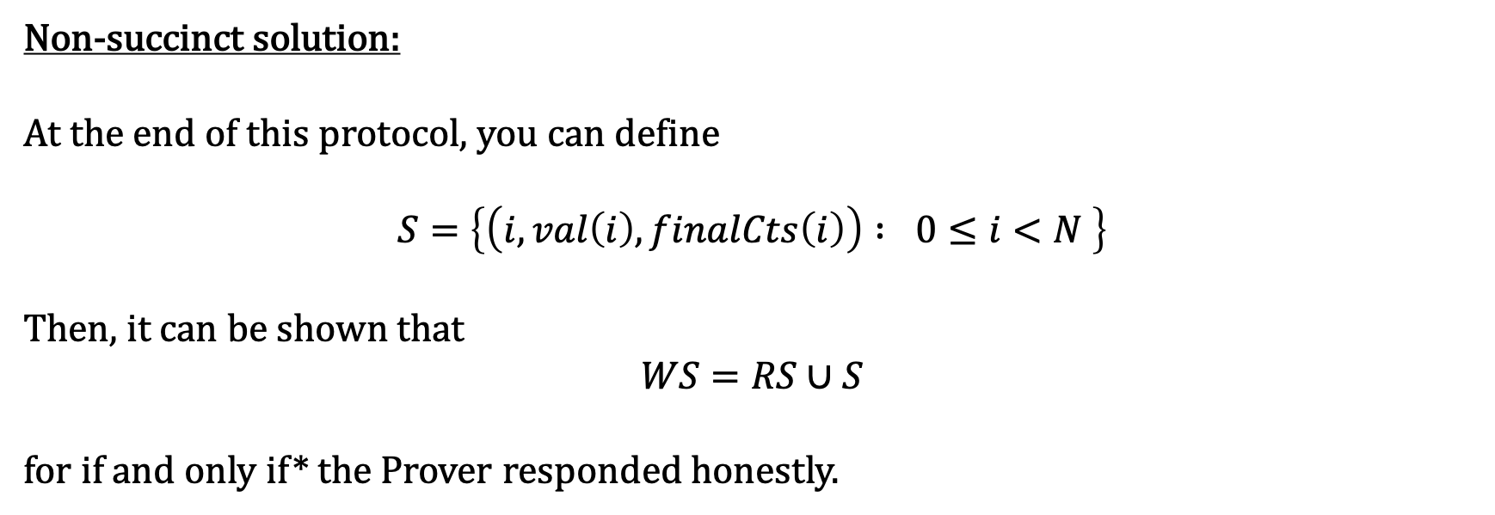
Offline memory checking: general solution
Non-succinct solution:
At the end of this protocol, you can define
$$S=\left\{\left(i, val\left(i\right), finalCts\left(i\right)\right) : 0≤i<N \right\}$$
Then, it can be shown that
$$WS=RS∪S$$
for if and only if* the Prover responded honestly.

Slide 9
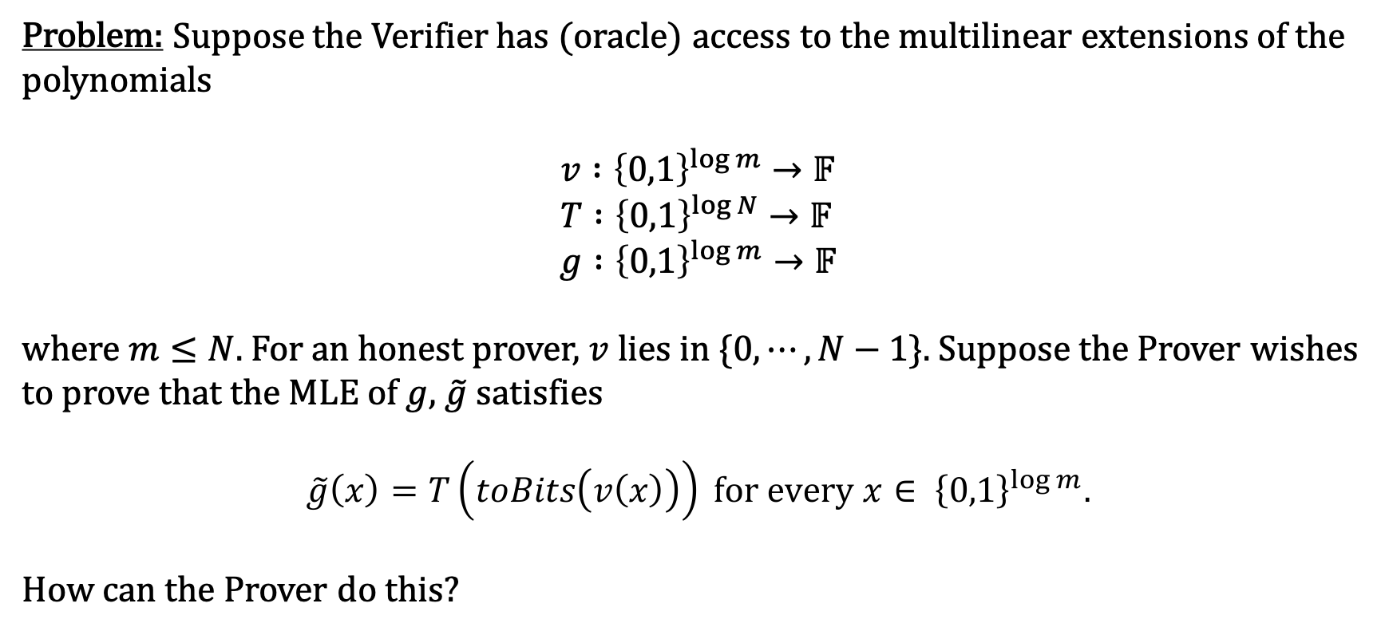
Offline memory checking: back to our problem
Problem: Suppose the Verifier has (oracle) access to the multilinear extensions of the polynomials
$$v :{\left\{0,1\right\}}^{\log{m}}→𝔽 \\ T :{\left\{0,1\right\}}^{\log{N}}→𝔽$$
$$g :{\left\{0,1\right\}}^{\log{m}}→𝔽$$
where $m≤N$. For an honest prover, $v$ lies in $\{0, ⋯, N−1\}$. Suppose the Prover wishes to prove that the MLE of $g$, $\tilde{g}$ satisfies
$$\tilde{g}\left(x\right)=T\left(toBits\left(v\left(x\right)\right)\right) \text{for} \text{every} x∈ {\left\{0,1\right\}}^{\log{m}}.$$
How can the Prover do this?

Slide 10
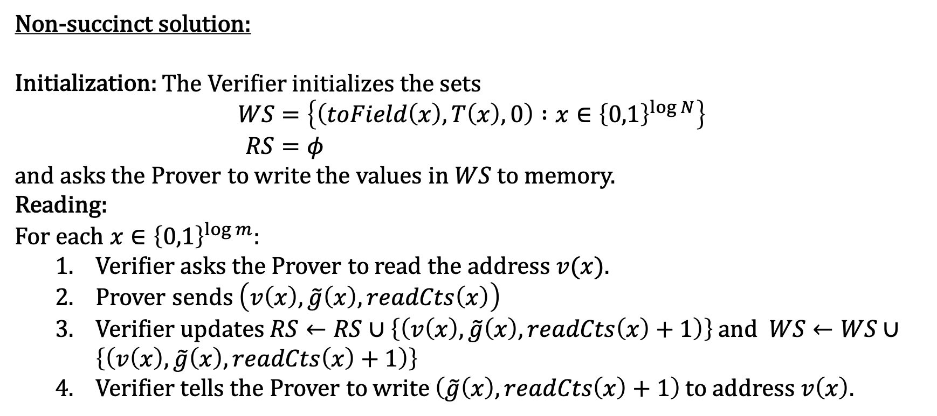
Offline memory checking: back to our problem
Non-succinct solution:
Initialization: The Verifier initializes the sets
$$WS=\left\{\left(toField\left(x\right), T\left(x\right), 0\right) :x∈{\left\{0,1\right\}}^{\log{N}}\right\} \\ RS=φ$$
and asks the Prover to write the values in $WS$ to memory.
Reading:
For each $x∈{\left\{0,1\right\}}^{\log{m}}$:
  Verifier asks the Prover to read the address $v(x)$.
  Prover sends $\left(v\left(x\right),\tilde{g}\left(x\right), readCts\left(x\right)\right)$
  Verifier updates $RS←RS∪\left\{\left(v\left(x\right), \tilde{g}\left(x\right), readCts\left(x\right)+1\right)\right\}$ and $WS←WS∪\left\{\left(v\left(x\right), \tilde{g}\left(x\right), readCts\left(x\right)+1\right)\right\}$
  Verifier tells the Prover to write $\left(\tilde{g}\left(x\right), readCts\left(x\right)+1\right)$ to address $v\left(x\right)$.

Slide 11
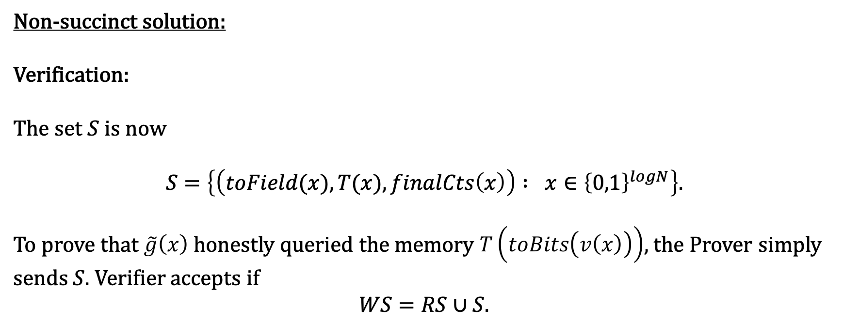
Offline memory checking: back to our problem
Non-succinct solution:
Verification:
The set $S$ is now
$$S=\left\{\left(toField(x), T(x), finalCts\left(x\right)\right) : x∈{\left\{0,1\right\}}^{logN}\right\}.$$
To prove that $\tilde{g}\left(x\right)$ honestly queried the memory $T\left(toBits\left(v\left(x\right)\right)\right)$, the Prover simply sends $S$. Verifier accepts if
$$WS=RS∪S.$$

Slide 12
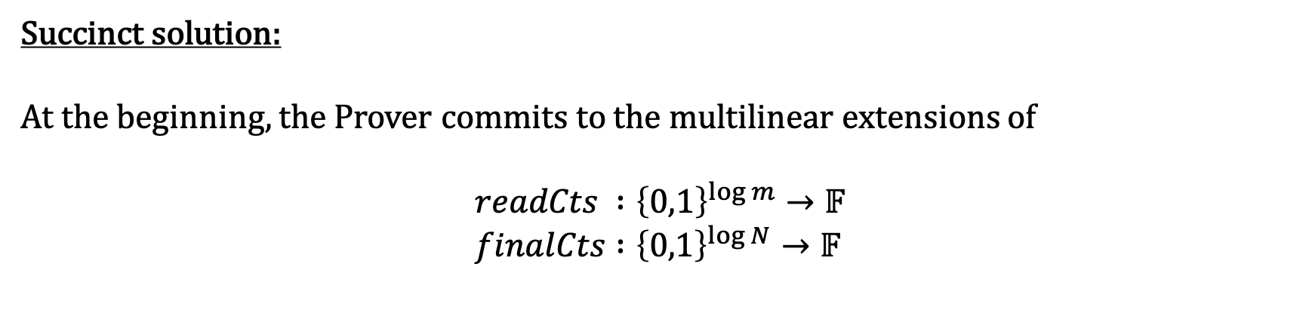

Offline memory checking: back to our problem
Succinct solution:
At the beginning, the Prover commits to the multilinear extensions of
$$readCts :{\left\{0,1\right\}}^{\log{m}}→𝔽 \\ finalCts :{\left\{0,1\right\}}^{\log{N}}→𝔽$$
Note these are all “small” field elements- at most $m$

Slide 13
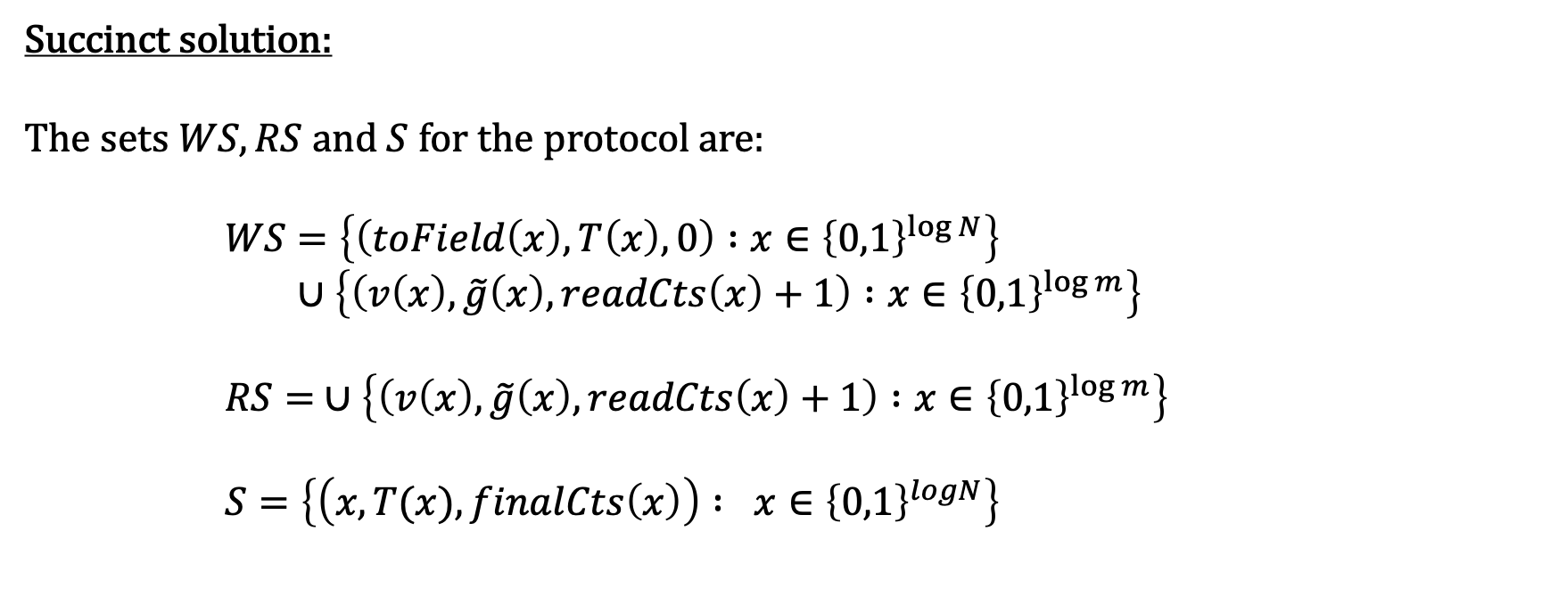
Offline memory checking: back to our problem
Succinct solution:
The sets $WS, RS$ and $S$ for the protocol are:
      $$WS=\left\{\left(toField\left(x\right), T\left(x\right), 0\right) :x∈{\left\{0,1\right\}}^{\log{N}}\right\} \\ ∪\left\{\left(v\left(x\right),\tilde{g}\left(x\right), readCts\left(x\right)+1\right) :x∈{\left\{0,1\right\}}^{\log{m}}\right\}$$
      $$RS= ∪\left\{\left(v\left(x\right),\tilde{g}\left(x\right), readCts\left(x\right)+1\right) :x∈{\left\{0,1\right\}}^{\log{m}}\right\}$$
      $$S=\left\{\left(x, T(x), finalCts\left(x\right)\right) : x∈{\left\{0,1\right\}}^{logN}\right\}$$

Slide 14
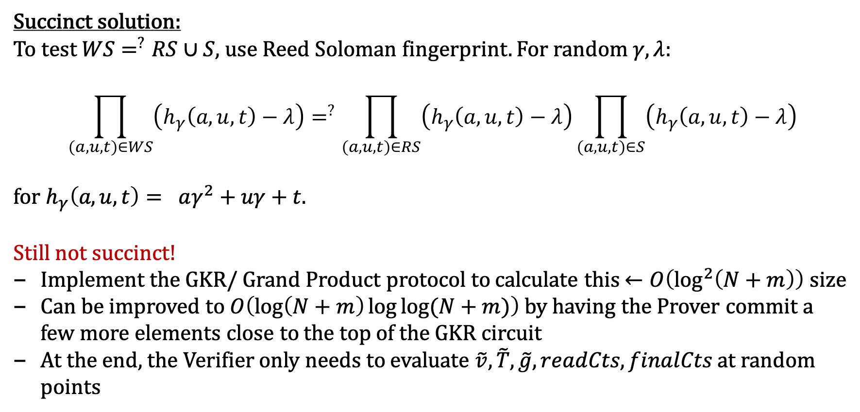
Offline memory checking: back to our problem
Succinct solution:
To test $WS=^{?}RS∪S$, use Reed Soloman fingerprint. For random $γ, λ$:
$$\prod_{\left(a,u,t\right)∈WS}{\left(h_{γ}\left(a,u,t\right)−λ\right)}=^{?}\prod_{\left(a,u,t\right)∈RS}{\left(h_{γ}\left(a,u,t\right)−λ\right)}\prod_{\left(a,u,t\right)∈S}{\left(h_{γ}\left(a,u,t\right)−λ\right)}$$
for $h_{γ}\left(a,u,t\right)= aγ^{2}+uγ+t$.
Still not succinct!
Implement the GKR/ Grand Product protocol to calculate this $←O\left(\log^{2}\left(N+m\right)\right)$ size
Can be improved to $O\left(\log\left(N+m\right)\log{\log{(N+m)}}\right)$ by having the Prover commit a few more elements close to the top of the GKR circuit
At the end, the Verifier only needs to evaluate $\tilde{v}, \tilde{T},\tilde{g}, readCts, finalCts$ at random points

Slide 15
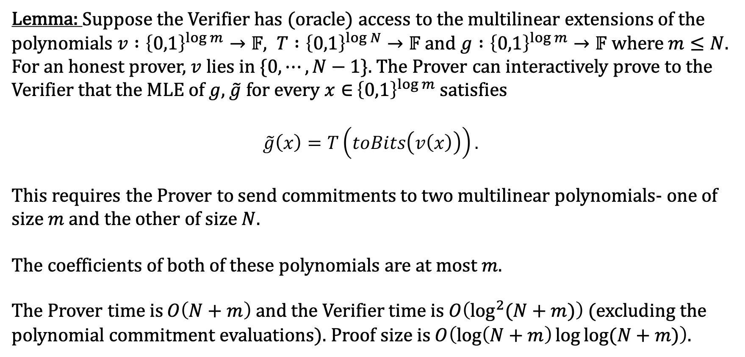
Offline memory checking: summary
Lemma: Suppose the Verifier has (oracle) access to the multilinear extensions of the polynomials $v :{\left\{0,1\right\}}^{\log{m}}→𝔽, T :{\left\{0,1\right\}}^{\log{N}}→𝔽$ and $g :{\left\{0,1\right\}}^{\log{m}}→𝔽$ where $m≤N$. For an honest prover, $v$ lies in $\{0, ⋯, N−1\}$. The Prover can interactively prove to the Verifier that the MLE of $g$, $\tilde{g}$ for every $x∈$ ${\left\{0,1\right\}}^{\log{m}}$ satisfies
$$\tilde{g}\left(x\right)=T\left(toBits\left(v\left(x\right)\right)\right).$$
This requires the Prover to send commitments to two multilinear polynomials- one of size $m$ and the other of size $N$.
The coefficients of both of these polynomials are at most $m$.
The Prover time is $O\left(N+m\right)$ and the Verifier time is $O\left(\log^{2}{(N+m)}\right)$ (excluding the polynomial commitment evaluations). Proof size is $O\left(\log\left(N+m\right)\log{\log{(N+m)}}\right)$.

Slide 16
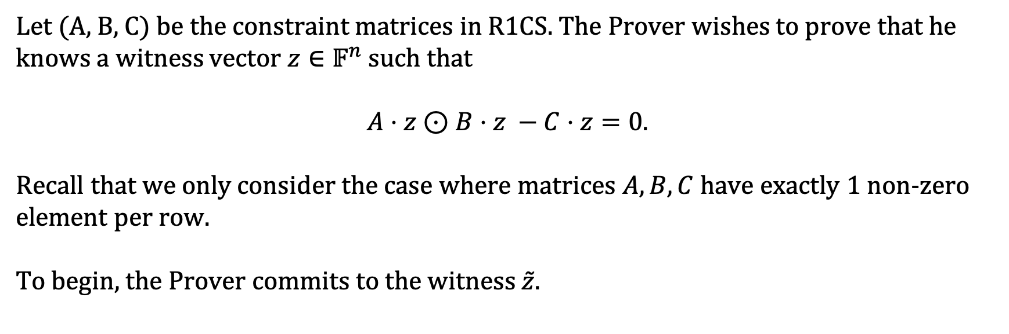
BabySpartan: R1CS
Let (A, B, C) be the constraint matrices in R1CS. The Prover wishes to prove that he knows a witness vector $z∈𝔽^{n}$ such that
$$A⋅z⊙B⋅z −C⋅z=0.$$
Recall that we only consider the case where matrices $A, B, C$ have exactly 1 non-zero element per row.
To begin, the Prover commits to the witness $\tilde{z}$.

Slide 17
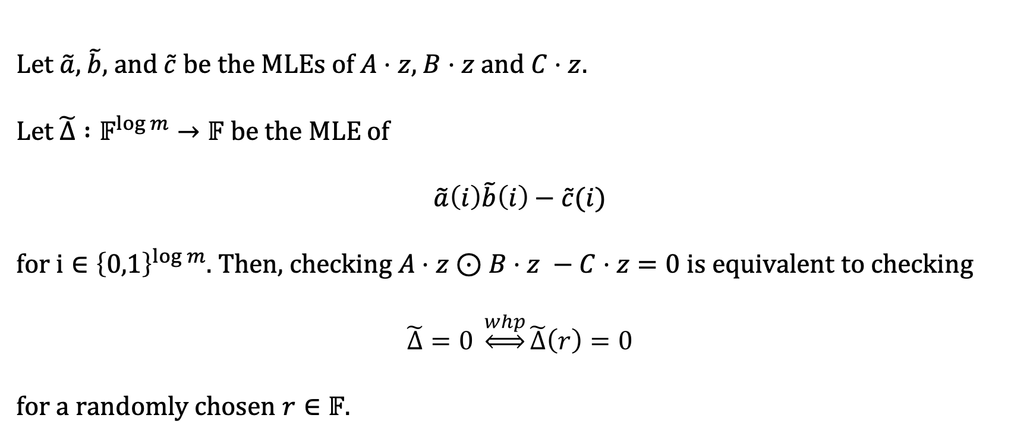
BabySpartan: R1CS
Public parameters: $A,B,C$
Commitments: $\tilde{z}$
Let $\tilde{a}$, $\tilde{b}$, and $\tilde{c}$ be the MLEs of $A⋅z$, $B⋅z$and $C⋅z$.
Let $\tilde{Δ} :𝔽^{\log{m}}→𝔽$ be the MLE of
$$\tilde{a}\left(i\right)\tilde{b}\left(i\right)−\tilde{c}(i)$$
for $i∈{\left\{0,1\right\}}^{\log{m}}$. Then, checking $A⋅z⊙B⋅z −C⋅z=0$ is equivalent to checking
$$\tilde{Δ}=0 \underset{⇔}{whp}\tilde{Δ}\left(r\right)=0$$
for a randomly chosen $r∈𝔽$.

Slide 18
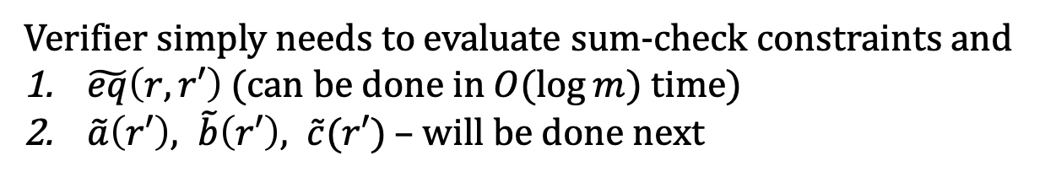

BabySpartan: R1CS
Public parameters: $A,B,C$
Commitments: $\tilde{z}$
For a randomly chosen $r∈𝔽$, check if
$$0=\tilde{Δ}\left(r\right) \\ = \sum_{x∈{\left\{0,1\right\}}^{\log{m}}}{\tilde{eq}\left(r,x\right)(\tilde{a}\left(x\right)\tilde{b}\left(x\right)−\tilde{c}(x))}$$
Use Sum-check to reduce this
Verifier simply needs to evaluate sum-check constraints and
$\tilde{eq}\left(r,r′\right)$ (can be done in $O(\log{m})$ time)
$\tilde{a}\left(r′\right), \tilde{b}\left(r′\right), \tilde{c}(r′)$ – will be done next

Slide 19
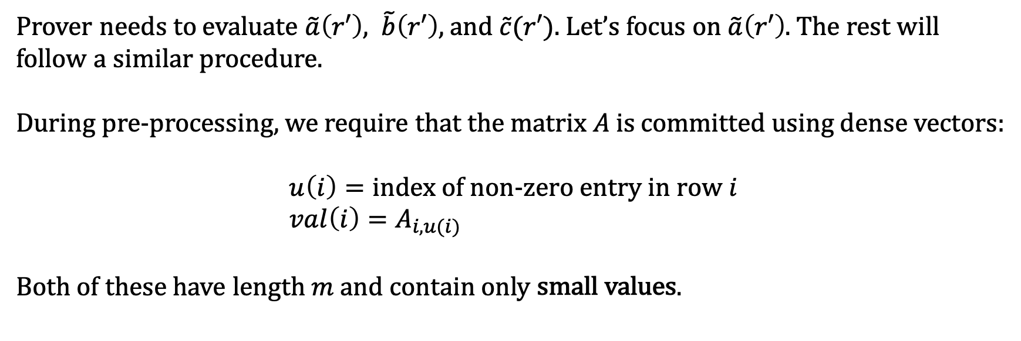
BabySpartan: R1CS
Public parameters: $A,B,C$
Commitments: $\tilde{z}$
Prover needs to evaluate $\tilde{a}\left(r′\right), \tilde{b}\left(r′\right),$ and $\tilde{c}(r′)$. Let’s focus on $\tilde{a}\left(r′\right)$. The rest will follow a similar procedure.
During pre-processing, we require that the matrix $A$ is committed using dense vectors:
$$u\left(i\right)=\text{index} \text{of} \text{non}\text{−}\text{zero} \text{entry} \text{in} \text{row} i \\ val\left(i\right)=A_{i, u(i)}$$
Both of these have length $m$ and contain only small values.

Slide 20
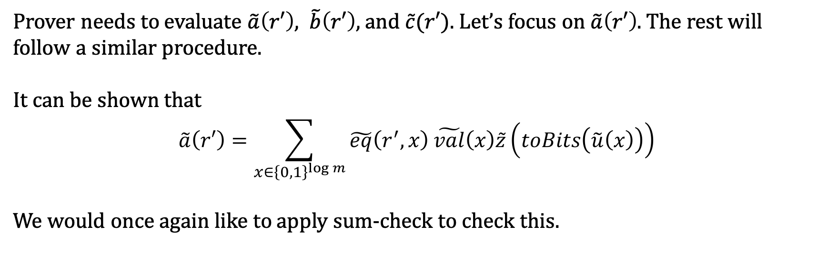
BabySpartan: R1CS
Public parameters: $A,\tilde{u},\tilde{val}, B,C$
Commitments: $\tilde{z}$
Prover needs to evaluate $\tilde{a}\left(r′\right), \tilde{b}\left(r′\right),$ and $\tilde{c}(r′)$. Let’s focus on $\tilde{a}\left(r′\right)$. The rest will follow a similar procedure.
It can be shown that
$$\tilde{a}\left(r′\right)=\sum_{x∈{\left\{0,1\right\}}^{\log{m}}}{\tilde{eq}\left(r^{′},x\right)}\tilde{val}\left(x\right)\tilde{z}\left(toBits\left(\tilde{u}\left(x\right)\right)\right)$$
We would once again like to apply sum-check to check this.

Slide 21
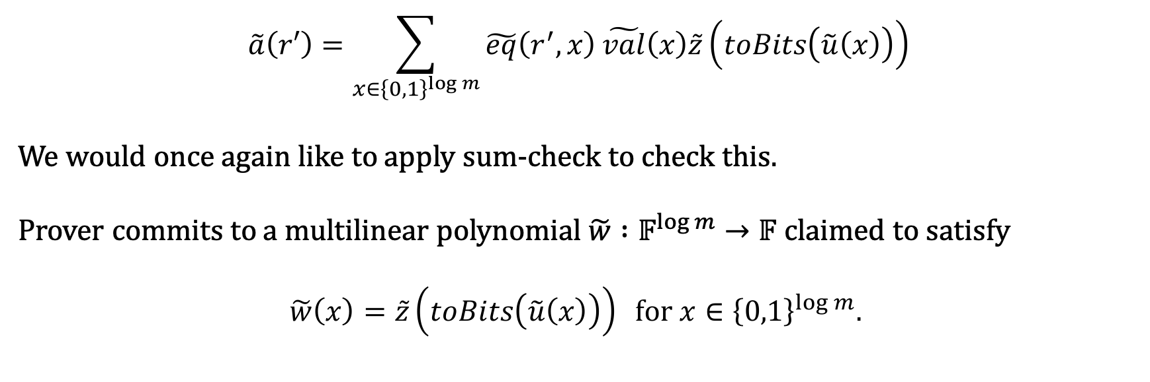
BabySpartan: R1CS
Public parameters: $A,\tilde{u},\tilde{val}, B,C$
Commitments: $\tilde{z}$
$$\tilde{a}\left(r′\right)=\sum_{x∈{\left\{0,1\right\}}^{\log{m}}}{\tilde{eq}\left(r^{′},x\right)}\tilde{val}\left(x\right)\tilde{z}\left(toBits\left(\tilde{u}\left(x\right)\right)\right)$$
We would once again like to apply sum-check to check this.
Prover commits to a multilinear polynomial $\tilde{w} :𝔽^{\log{m}}→𝔽$ claimed to satisfy
$$\tilde{w}\left(x\right)=\tilde{z}\left(toBits\left(\tilde{u}\left(x\right)\right)\right) \text{for} x∈{\left\{0,1\right\}}^{\log{m}}.$$
This can be checked using the Offline Memory Checking procedure

Slide 22
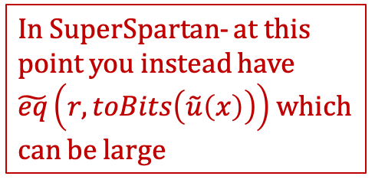
BabySpartan: R1CS
Public parameters: $A,\tilde{u},\tilde{val},readCts, finalCts, B,C$
Commitments: $\tilde{z}$
$$\tilde{a}\left(r′\right)=\sum_{x∈{\left\{0,1\right\}}^{\log{m}}}{\tilde{eq}\left(r^{′},x\right)}\tilde{val}\left(x\right)\tilde{z}\left(toBits\left(\tilde{u}\left(x\right)\right)\right)$$
We would once again like to apply sum-check to check this.
Prover commits to a multilinear polynomial $\tilde{w} :𝔽^{\log{m}}→𝔽$ claimed to satisfy
$$\tilde{w}\left(x\right)=\tilde{z}\left(toBits\left(\tilde{u}\left(x\right)\right)\right) \text{for} x∈{\left\{0,1\right\}}^{\log{m}}.$$
In SuperSpartan- at this point you instead have $\tilde{eq}\left(r,toBits\left(\tilde{u}\left(x\right)\right)\right)$which can be large

Slide 23


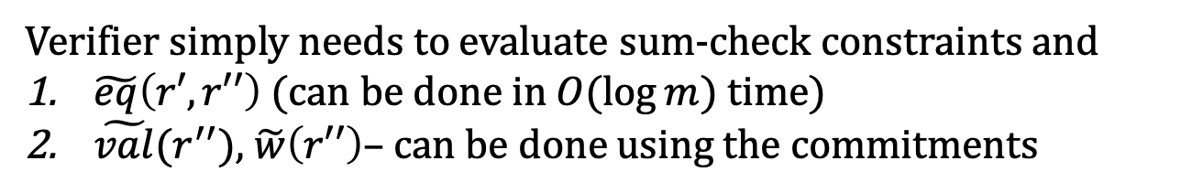
BabySpartan: R1CS
Public parameters: $A,\tilde{u},\tilde{val},readCts, finalCts, B,C$
Commitments: $\tilde{z}$and $\tilde{w}$
$$\tilde{a}\left(r′\right)=\sum_{x∈{\left\{0,1\right\}}^{\log{m}}}{\tilde{eq}\left(r′,x\right)}\tilde{val}\left(x\right)\tilde{w}\left(x\right)$$
Use Sum-check to reduce this
Verifier simply needs to evaluate sum-check constraints and
$\tilde{eq}\left(r′,r′′\right)$ (can be done in $O(\log{m})$ time)
$\tilde{val}(r^{′′})$, $\tilde{w}\left(r′′\right)$– can be done using the commitments

Slide 24
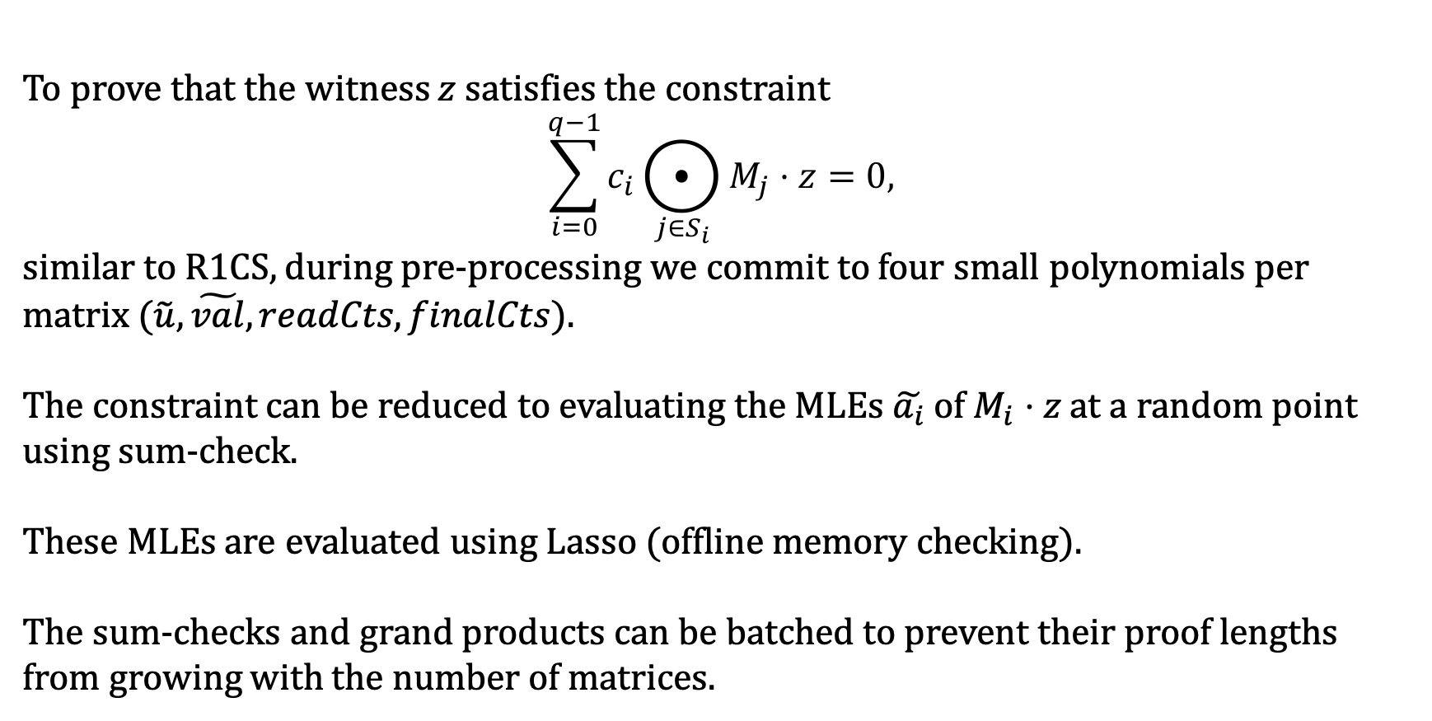
BabySpartan: CCS
To prove that the witness $z$satisfies the constraint
$$\sum_{i=0}^{q−1}{c_{i}⨀_{j∈S_{i}}{M_{j}⋅z}}=0,$$
similar to R1CS, during pre-processing we commit to four small polynomials per matrix ($\tilde{u},\tilde{val}, readCts, finalCts$).
The constraint can be reduced to evaluating the MLEs $\tilde{a_{i}}$ of $M_{i}⋅z$ at a random point using sum-check.
These MLEs are evaluated using Lasso (offline memory checking).
The sum-checks and grand products can be batched to prevent their proof lengths from growing with the number of matrices.

Slide 25
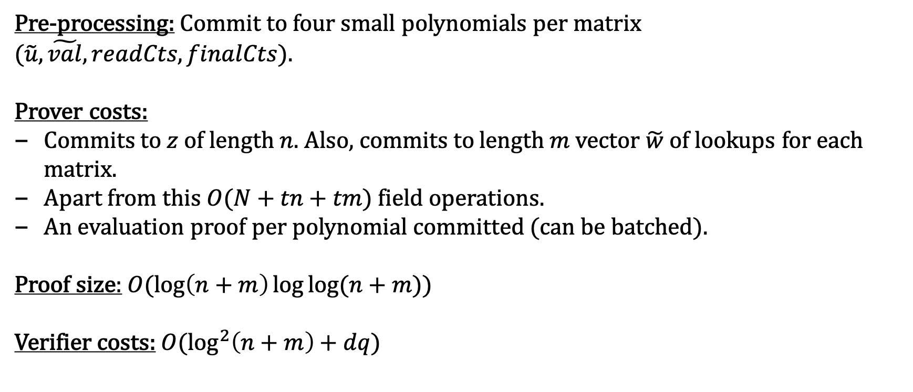
BabySpartan: Costs
Pre-processing: Commit to four small polynomials per matrix ($\tilde{u},\tilde{val}, readCts, finalCts$).
Prover costs:
Commits to $z$ of length $n$. Also, commits to length $m$ vector $\tilde{w}$ of lookups for each matrix.
Apart from this $O(N+tn+tm)$ field operations.
An evaluation proof per polynomial committed (can be batched).
Proof size: $O(\log\left(n+m\right)\log{\log{(n+m)}})$
Verifier costs: $O(\log^{2}\left(n+m\right)+dq)$

Slide 26
Thank you.

